Slide 1
Treasure Hoarder
Group 5
Drew Barlow
Daniel Mack
Devin Pesmark
Dominic Verardi
Kirk Caponpon

Slide 2

Game Overview
Genre: Pirate action roguelike
Player type: Single player
Story: You are an infamous pirate that has recently gone into retirement on a deserted island with the vast riches you’ve accrued over the years. The other pirates and monsters have gotten greedy and believe you to be old now. Therefore, not much of a threat and are trying to steal your gold. You must defend against these pirates and monsters whose goal is to steal your treasure.
Player Sprite

Slide 3
Game Elements
Avoiding and shooting at enemies.
Collecting drops (from killing enemies) that helps the player purchase player upgrades in the in-game store
While playing in-game, the player is able to pick up drops that exponentially helps the player defeat more enemies.
Upgrades:
Temporary Speed Boost
Bomb that destorys all enemies on screen

Slide 4
Key Features
Shop System & Random Drops
the shop is in the menus
the shop allows the player to upgrade their arsenal
Perminate speed upgrade
Health increases
Enemies - There will be constantly spawning enemies around the player whose goal is to move towards that player and damage them when coming in contact.
Pirate - This will be the main character that the player will be able to control to fight against the enemies
Weapons - The player will have two weapons to switch between, a shotgun and a pistol
Drops - These upgrades will be dropped randomly by enemies throughout a “run” (A run in this case is a full play through from pressing play until the player dies to the enemies). These upgrades are short dureation speed boost or a bomb that destoryes all enemies on screen.

Slide 5
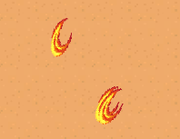
Game Mechanics
Bullet Sprites
Move Controls: WASD
to stay away from the enemies and aim with the mouse.
Shooting: Left Mouse Button
Shooting either the shotgun or pistol
The number keys of 1 and 2 will be used to switch to other weapons that the player can unlock in the game.
The enemies will be locked onto the player and are constantly moving towards them at a given speed.

Slide 6
Gameplay
The player would move and shoot around avoiding enemies from getting close to them, while having the objective of surviving for a set amount of time. If the player survives at the set amount of time, a final enemy would appear. In the opposite manner, if the player dies within the time limit, they would lose. This random drop of upgrades would allow the player to have an easier time of surviving.

Slide 7
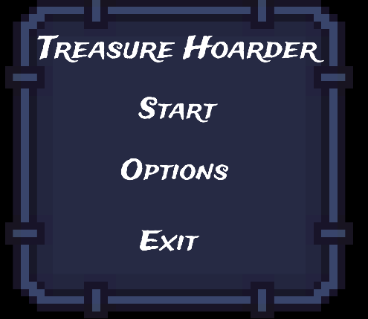
Game UI
Main Menu Features:
Start Button: Loads the next game scene
Options Button: When pressed, loads an options menu that lets the player do the following - adjust volume, select a controls button (how to play) and select a back button to the main menu.
Exit Button: Quits the game.
Pause Menu Features:
Resume Button: Resumes the current game scene.
Options Button: When pressed loads an options menu that lets the player do the following - adjust volume, select a controls button (how to play) and select a back button to the pause menu.
Exit Button: Quits the game.
Main Menu / Pause Menu

Slide 8
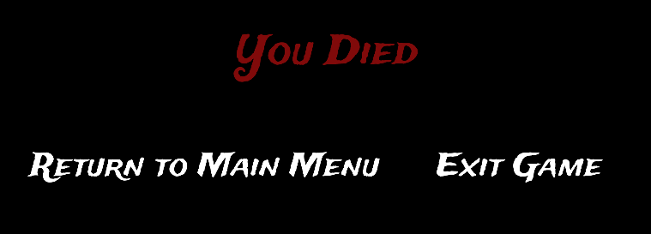
Game UI Continued
Game Over Screen:
Displays a game over / death message.
Return to main menu button: Returns the player back to the main menu.
Exit button: Quits the game.
Game Over / Death Screen

Slide 9
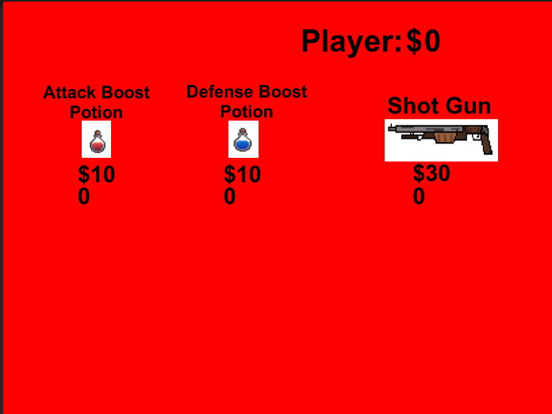
Item Shop
Item Shop is design for the player to buy items for the game. For example, if you buy the attack potion, that potion should increase your player’s attack power. In order to get these items, you need to collect coins from the enemies from the game.

Slide 10
Item Shop Part 2
While buying these items, they can be use in game. More choices you can choose while fighting off the enemies.
Attack Potion: Attack power increase by 25%
Defense Potion: Defense power increase by 25%
Shotgun: Shoots 2 projectiles

Slide 11

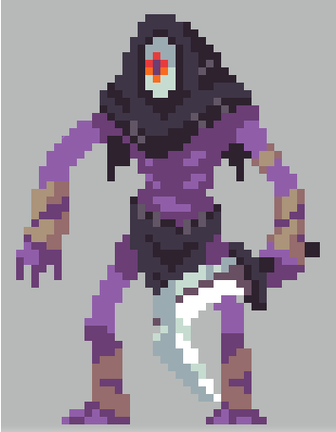


Enemies - Types
There are 4 different enemy types in our game
Skeleton - Normal health, slower speed, and normal attack
Barrel - Lower health, faster speed, and lower attack
Thief - Normal health, faster speed, and normal attack
Bringer - Unkillable, very fast speed, and very high attack
Skeleton Enemy Sprite | Thief Enemy Sprite | Barrel Enemy Sprite | Bringer Enemy Sprite

Slide 12
Enemy - spawning
A wave of 20 enemies will spawn every 30 seconds
The enemy type that’s spawned is dependent on the time:
0 - 5 minutes: Skeleton
5 - 10 minutes: Barrel
10 - 15 minutes: Thief
At 15 minutes the Bringer will be spawned and kill the player
Once spawning is initiated, an enemy will spawn every second until all 20 have spawned
They will spawn at a random spot around the player and walk towards the player to attack them

Slide 13
References
Assets: https://itch.io/
Font: https://www.1001fonts.com/
Sounds: https://xdeviruchi.itch.io/8-bit-fantasy-adventure-music-pack
https://opengameart.org/

